Slide 1
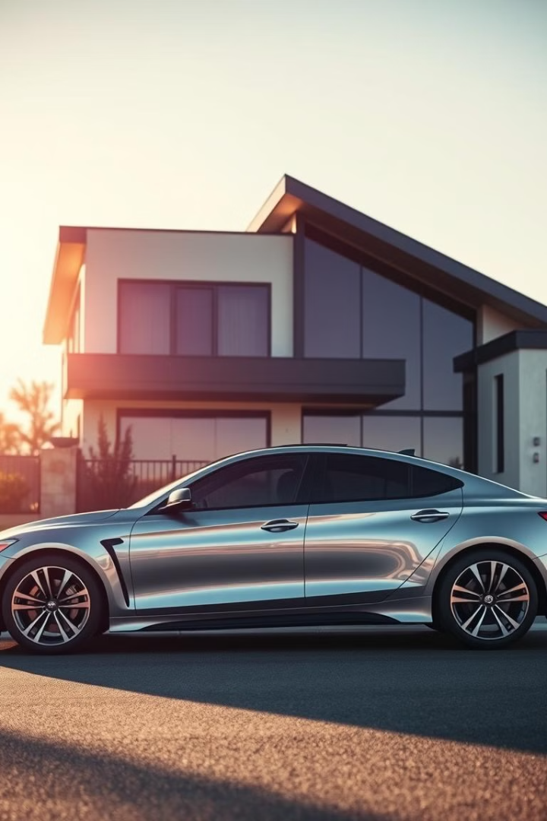
Used Cars Price Analysis
Presented By:
Narla gagan raj

Slide 2
ABSTRACT
In this project, we studied about used car prices from different brands.
We used web scraping to collect data from a car-selling website.
Then we cleaned the data and analyzed it using charts.
Our goal was to find which cars give good quality at a low price.

Slide 3
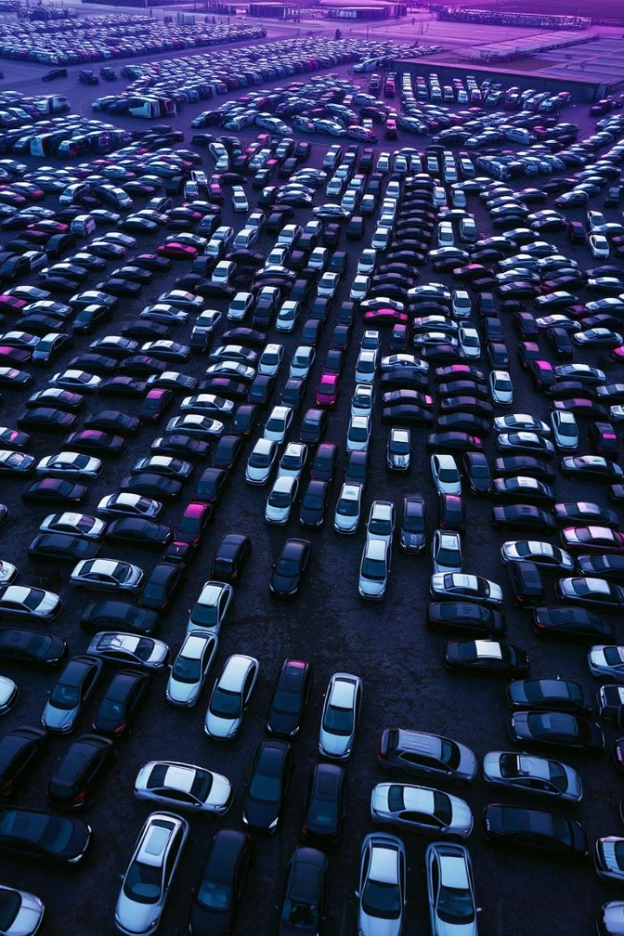
Introduction
Used cars are getting popular because they cost less than new ones.
But prices can change a lot depending on the brand, fuel type, etc.
This project helps people understand car prices and which brands offer value for money.

Slide 4
Project Objective
To study car price variation based on brands.
To find high-quality cars that are available at low prices.
To understand what factors affect car prices.
To make it easier for people to choose a good used car.

Slide 5

Tools Used
Python – for web scraping and data analysis
Pandas – for cleaning and handling data
Matplotlib / Seaborn – for data visualization
Power BI – to create dashboards
Excel/CSV – to save and manage data

Slide 6
Data Collection
Data was collected using web scraping from Spinny website.
It includes information like brand, price, fuel type, car model, etc.
Data was saved in a CSV file for further use.

Slide 7
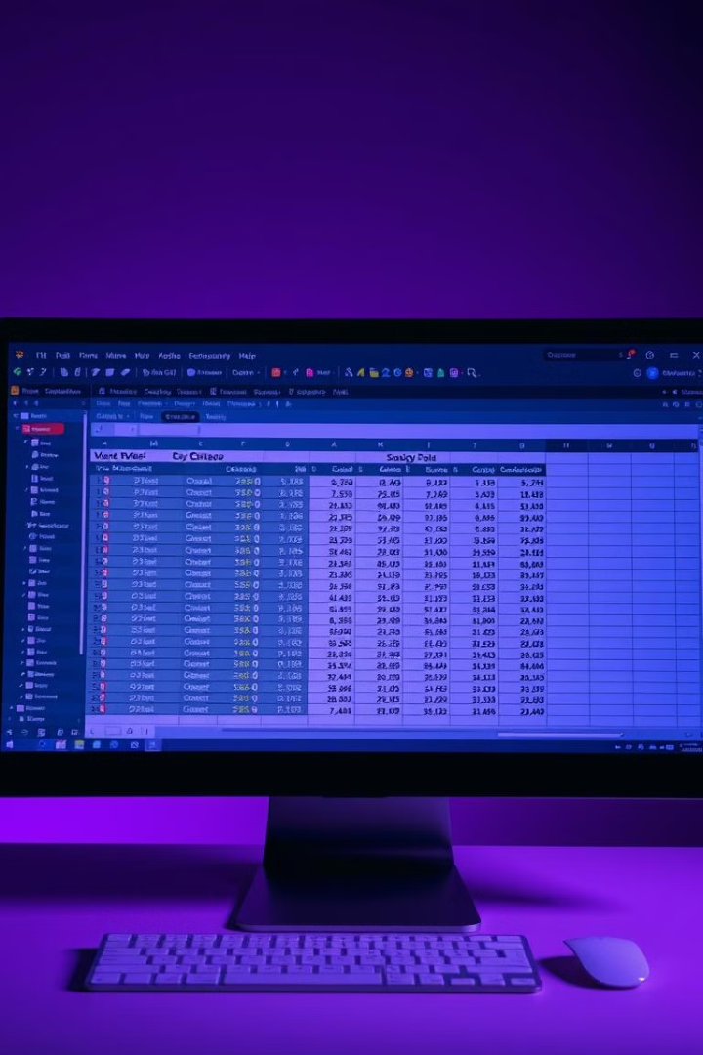
Data Cleaning
Removed missing or incorrect values
Fixed data types (like numbers and text)
Made column names simple and easy to read
Cleaned brand names and price values

Slide 8
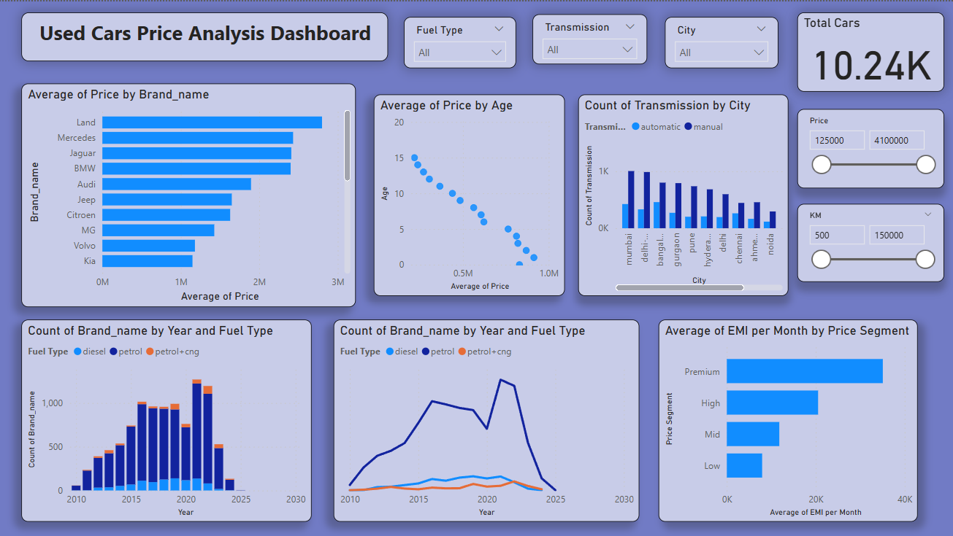
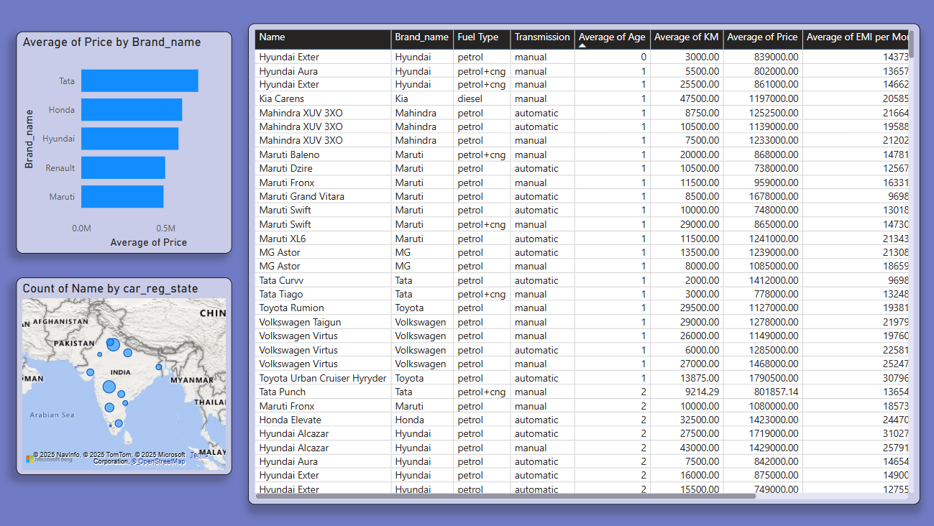
Dashboards

Slide 9
Key Findings
Top Brands: Maruti, Hyundai, Honda had more used cars.
Fuel Types: Petrol cars were more common than diesel.
Price Range: Many good cars were available between ₹2 lakhs to ₹5 lakhs.
Best Value: Some brands offered low-price cars with good quality and features.
City Effect: Car prices varied by city/location.

Slide 10
Conclusion
Car price depends on brand, fuel, model, and condition.
Some brands give better quality cars at lower prices.
This data analysis helps buyers make smarter decisions.
This project was useful to learn about data handling, tools, and real-life problems.

Slide 11

THANK YOU
ANY QUERIES?

